Slide 1
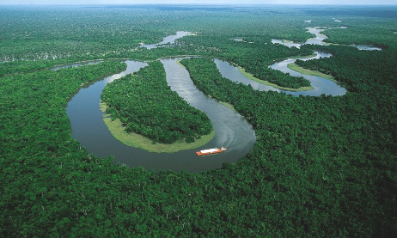
Rainforests
Year 8 Altior Geography – Headstart 2022

Slide 2
What is geography?
https://www.youtube.com/watch?v=93LLwiMjDko&feature=youtu.be

Slide 3
As a student of Geography, you are starting to build the knowledge and skills that will be needed by you and your community now and into the future. The concepts and skills that you will use will not only help you in Geography but they can also be applied to everyday situations, such as finding your way from one place to another.

Slide 4
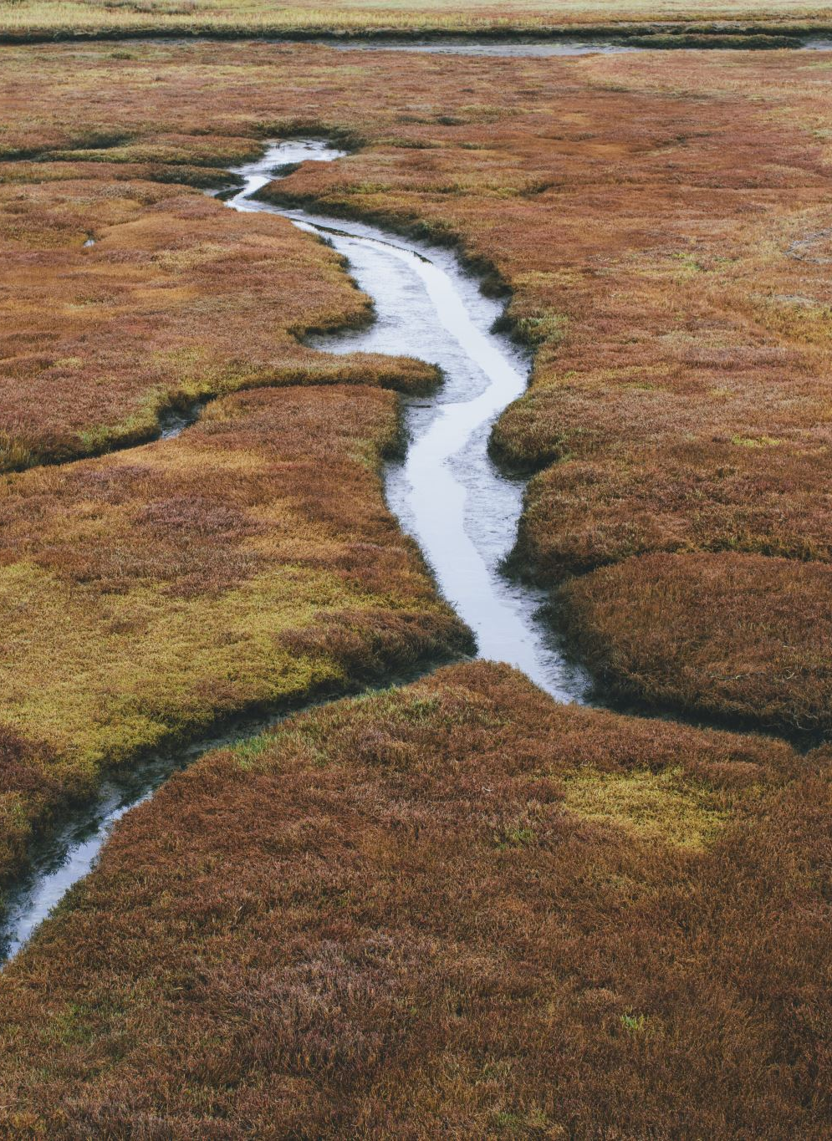
Learning Intentions:
Understand concepts related to rainforests
Analyse distribution patterns of rainforests across the world
Identify different characteristics of rainforests across the world. For example, Montane rainforests; lowland rainforests; and, temperate rainforests.

Slide 5
Different types of landscapes
Mountains
Polar regions
Deserts
Karst landscapes
Rainforests
Aquatic landscapes
Grasslands
Islands
Built landscapes

Slide 6
What do you know about rainforests?
Many animals exist there
Rainforests are usually tropical and wet forest-like lands.

Slide 7
Q
Why are rainforests hot all year round?
List 10 characteristics of rainforests (e.g. high biodiversity).
Why are tropical rainforests so important?
What is an Ecosystem?
Why are tropical rainforests of the world distributed very close to the equator?
Aztec ants and Cecropia trees need each other. They are inseparable. Explain.
Explain how deforestation leads to lower soil fertility.
Explain what BOLTSS stands for and how to use it.
Name 5 different landforms.

Slide 8
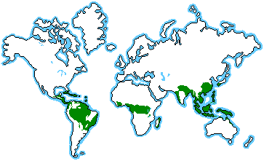
The tropical rain forest can be found in three major geographical areas around the world.
Central America in the Amazon river basin.
Africa - Zaire basin, with a small area in West Africa; also eastern Madagascar.
Indo-Malaysia - west coast of India, Assam, Southeast Asia, New Guinea and Queensland, Australia.
Notes:
Answer

Slide 9
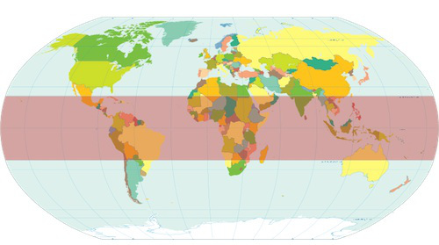
Notes:
Draw an imaginary line with your finger in the middle of the earth map. This represents the equator. A little above and a little below the equator are the “Tropics.” - The shaded red areas below are where the “Tropics” are located. - The northern “border” is the Tropic of Cancer, and the southern “border” is the Tropic of Capricorn.

Slide 10
Choose 1 to investigate:
You have 20 minutes to learn as much as you can about either:
Lowland Rainforest
Temperate Rainforests
Montane Rainforest
BE SURE TO: Define; List key characteristics; Build on one example (Amazon, etc.); Compare.

Slide 11
6.2: Generally…
Rainforests are:
Constantly wet
Located wherever the annual rainfall is more than 1300 millimetres
High temperatures and high precipitation
Thunderstorms are common
Warmer at night
Consistent weather throughout the year (no summer and no winter)
Notes:
Convectional rainfall occurs when warm, moist air is heated when it moves over a hot surface on Earth. As the air is heated it expands and becomes lighter than the surrounding air. This causes it to rise. If the air continues to rise, condensation and precipitation occur. This combination of high temperatures and high precipitation influences the global distribution of the tropical rainforest landscape.

Slide 12
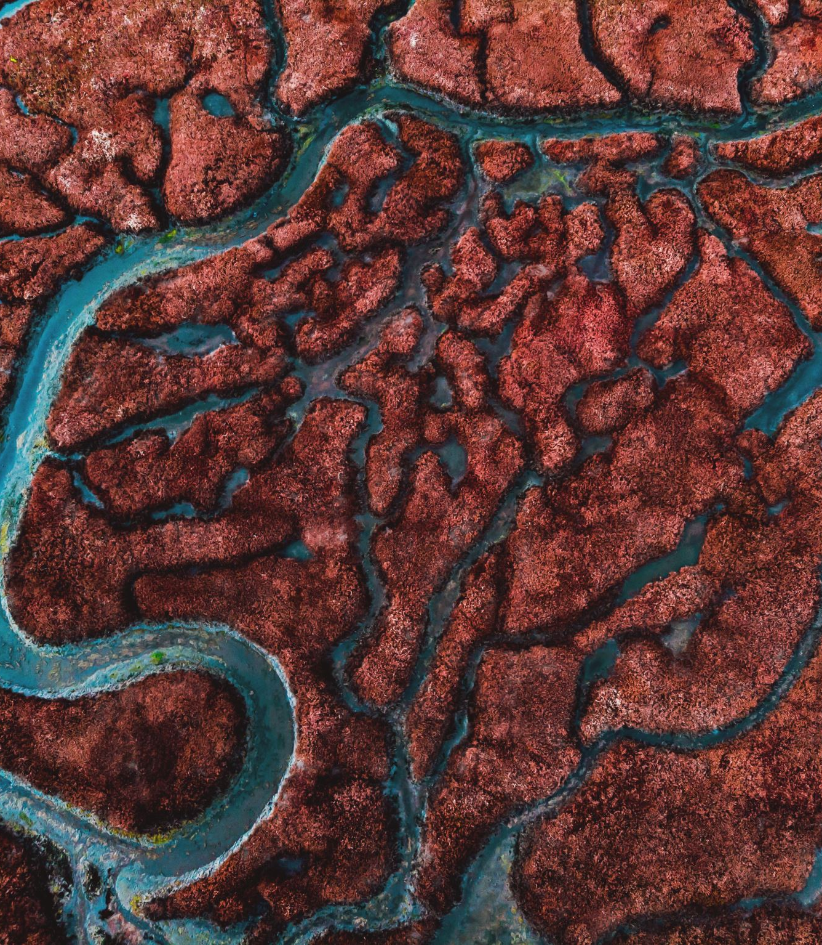
Montane rainforests
Tropical rainforests that occur in the mountains, 1000 metres or more above sea level, are called montane rainforests.

Slide 13
Lowland tropical rainforests
Form the majority of the world’s tropical rainforests
Trees in lowland forests are usually taller
Greater diversity of fruiting trees
More threatened than montane forests
Accessibility, soils more suitable for agriculture and more valuable hardwoods for timber.
Lowland forests occur in a belt around the equator, with the largest areas in the Amazon Basin of South America, the Congo Basin of central Africa, Indonesia and New Guinea.

Slide 14
Temperate Rainforests
Situated between the tropics and the polar regions
North America, Tasmania, New Zealand and China

Slide 15
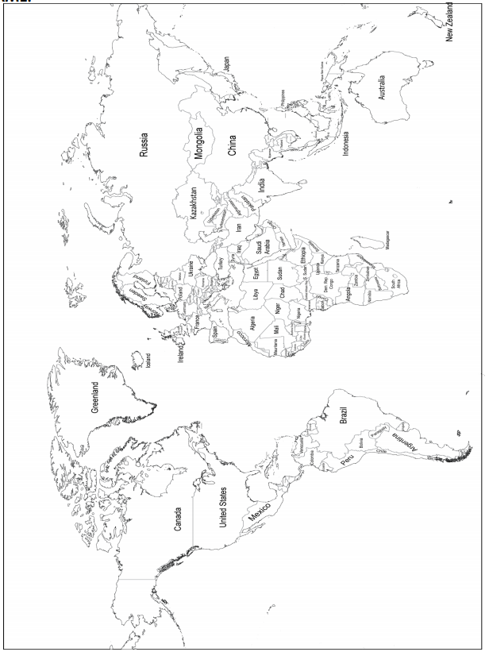
Mark the locations of:
Lowland
Temperate
Montane
Rainforests.

Slide 16
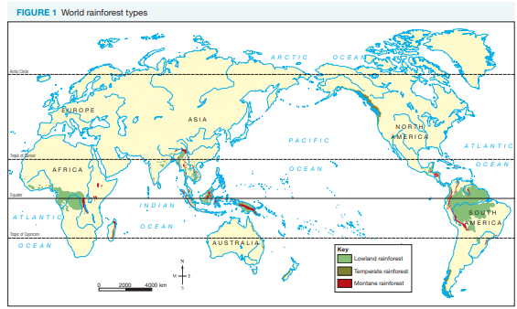

Slide 17
Concepts and skills used in geography
BOLTSS and SPICESS

Slide 18
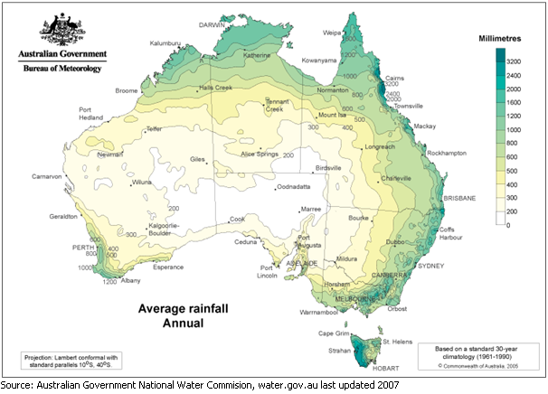
BOLTSS
BOLTSS? That’s Borders, Orientation, Legend, Title, Scale and Source
BORDER
This is pretty straightforward – it’s the frame. The four straight lines that show where your map begins and ends. Make sure it’s obvious where your map edges are.
ORIENTATION
Which way is north? This is important to know when you’re trying to read a map, so include a north-pointing arrow or a full compass rose somewhere out of the way.
LEGEND
If you’ve decided an upside-down V means “mountain”, or bright orange means heavy rainfall, you have to let your map-readers know. Include a box in the corner that explains the meaning of all your symbols and colours.
Notes:
https://astar.tv/geography-learn-map-bolts/

Slide 19
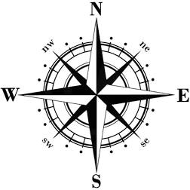
BOLTSS
BOLTSS? That’s Borders, Orientation, Legend, Title, Scale and Source
TITLE
What are we looking at here? Include a title so people know if this is a map of your favourite fishing site, all of Wollongong, East Germany in the 1970s or the Forbidden Forest on Hogwarts grounds.
SCALE
To be useful, a map has to tell you how much distance is covered by, say, each centimetre. This can be expressed as a drawn line, like a 4cm line that’s equivalent to 4km on the ground, a sentence that explains that “1cm is equivalent to 1km on the ground”, or as a ratio like 1cm:100,000kms.
SOURCE
It is always useful to know the origin of a map. A map should be accurately sourced so that the reader knows where the information comes from.
Notes:
https://astar.tv/geography-learn-map-bolts/

Slide 20
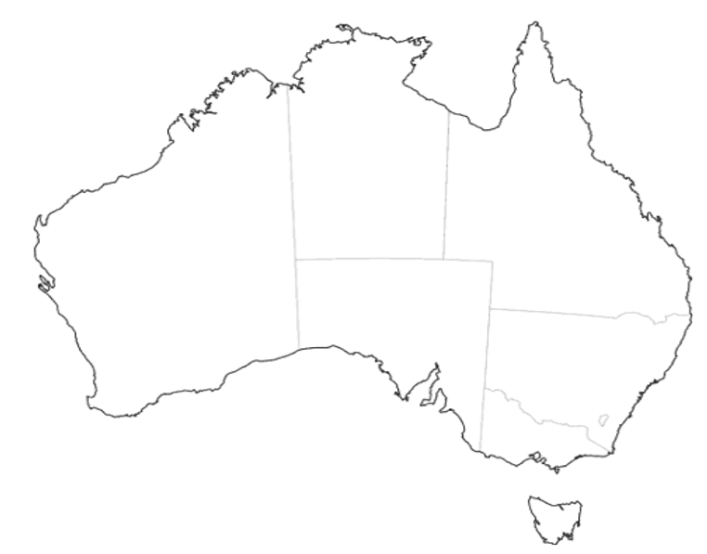
1. Use different colours to highlight the exact location of Australia’s montane, temperate, and lowland rainforest.
2. Use BOLTSS to complete the map.
3. What does BOLTSS stand for?
B –
O –
L –
T –
S –
S –

Slide 21
Rainforests
Year 8 Geography

Slide 22
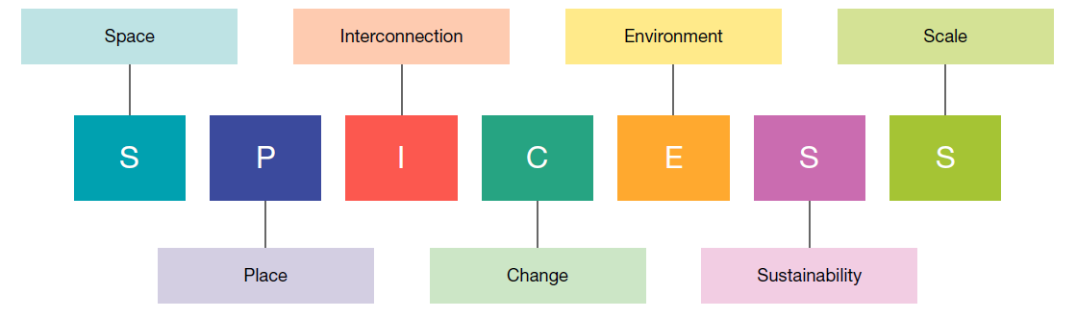
SPICESS
Geographical concepts help you to make sense of your world. By using these concepts you can both investigate and understand the world you live in, and you can use them to try to imagine a different world. The concepts help you to think geographically. There are seven major concepts: space, place, interconnection, change, environment, sustainability and scale.

Slide 23
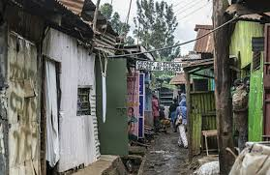
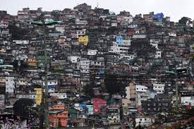
SPICESS
SPACE
Everything has a location on the space that is the surface of the Earth, and studying the effects of location, the distribution of things across this space, and how the space is organised and managed by people, helps us to understand why the world is like it is. When we talk about space it is usually in conjunction with place.
PLACE
Place refers to the location of objects/features on the earth’s surface. We define the place of an object in 2 ways - via its absolute location or its relative location. Absolute location: this can be pin pointed on a map. It can be given in the form of co-ordinates of latitude and longitude or an address. Relative location: this is a description of the objects/features location from a known point. It can be given as 30km north-west of Melbourne CDB or 1 hours drive south-east of Eltham.

Slide 24
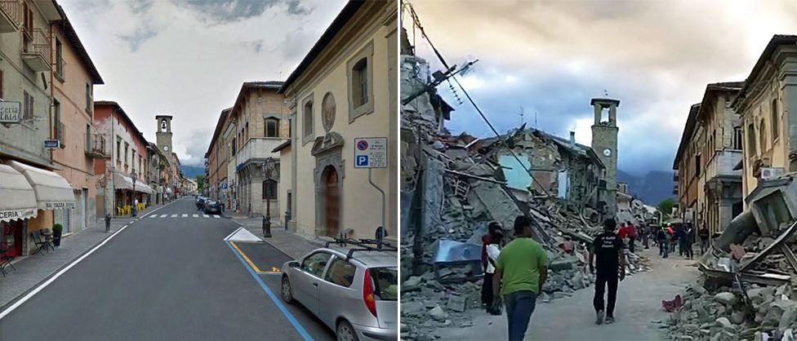
SPICESS
INTERCONNECTION
This explains the relationship between 2 places, features or objects, and understanding these connections helps us to understand how and why places are changing. We often refer to interconnection between natural and human features.
An example of interconnection includes the strong relationship between the amount of rainfall in Australia and where the people of Australia live. The more water/rainfall the higher population density, less water/rainfall less population density.
CHANGE
The concept of change is about using time to better understand a place, an environment, a spatial pattern or a geographical problem. Some changes can be fast and easily observed, but others are very slow. Cities, for example, can expand outwards over a number of years. However, landscape change can be very fast, as is the case with earthquakes and volcanic eruptions.

Slide 25

SPICESS
ENVIRONMENT:
Can be defined as the physical and biophysical environment that provide the necessary resources to support all life on earth. This is the surrounding of an organism or population, and includes the factors that have an influence on their survival, development and evolution
SUSTAINABILITY:
Sustainability is about maintaining the capacity of the environment to support our lives and those of other living creatures. Sustainability is about the interconnection between the human and natural world and who gets which resources and where, in relation to conservation of these resources and prevention of environmental damage.
SCALE:
When we examine geographical questions at different spatial levels - we use the concept of scale to find more complete answers.

Slide 26
SCALE EXAMPLE
 | Governing Bodies | Urban environments
Personal | Parents | Bedroom
Local | Local council | Suburb
Regional | State Government | State
National | Federal Government | Country
World | United Nations | Global environment

Slide 27
Rainforests
Year 8 Geography

Slide 28
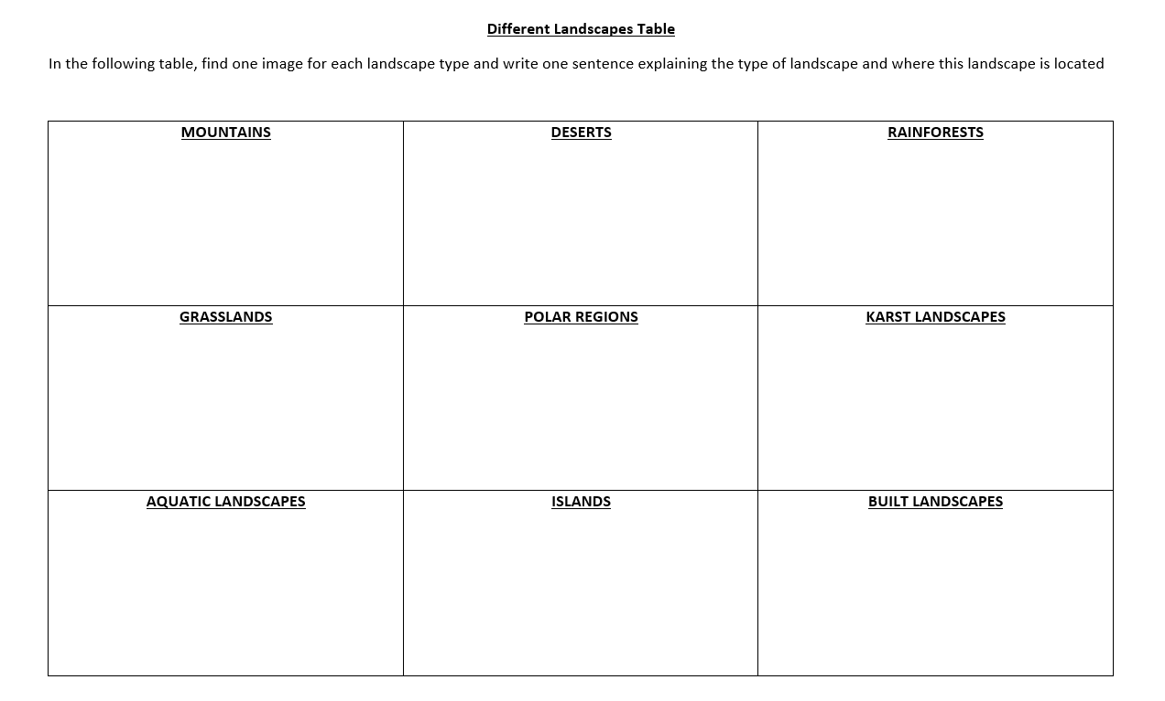
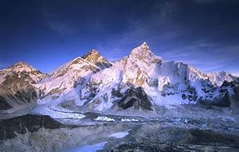
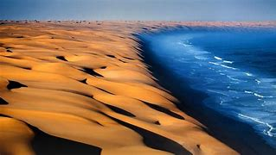
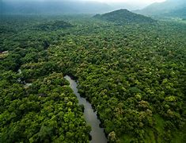
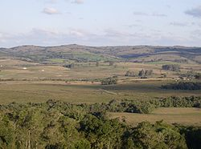
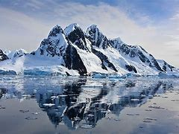
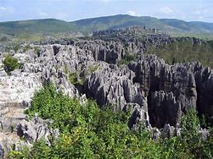
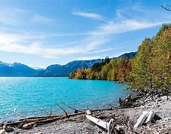
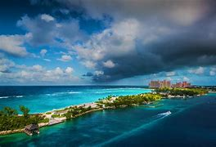
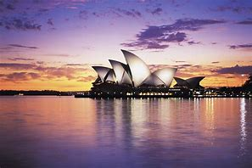

Slide 29
Example: Mount Everest
A mountain is a usually pointy landscape that reaches high into the clouds, usually rocky and/or snowy.
Example: Atlantic Coastal Desert
A desert is a large plot of sand, usually orange or yellow, and doesn’t contain much natural life such as trees.
Example: Amazon Rainforest
A rainforest is a mostly wet forest that’s located near the equator and requires at least 1300mm of rain every year.
Example: Pampas
A grassland is a hilly field of grass, usually containing different animals and plants.
Example: Antarctica
A Polar region is a hilly or flat land filled with either snow, water or ice. Most can be found at the top and the bottom of Earth.
Example: Shilin
A Karst Landscape is a field of tall rocks, on what looks like a mountain. Usually, there is also grass.
Example: Abraham Lake
An Aquatic Landscape is a hill or field which contains a waterfall, lake, pond and/or other source of water. The water portion can range in sizes.
Example: The Bahamas
An island is a small section of land surrounded by water. It can inhabit most other landscapes listed above, like rainforest, grasslands and built landscapes occasionally.
Example: Sydney Opera House
A Built Landscape is a tower, building or project created by humans and not nature. They can inhabit any other landscape here.

Slide 30
Landscapes & landforms
2021

Slide 31
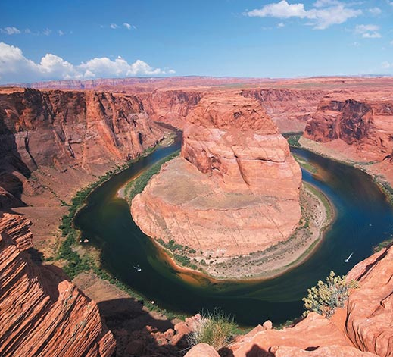
Introducing landscapes and landforms
Landscapes are the visible features of the land
These range from the icy landscapes in polar regions to lofty mountain ranges
Includes forests, deserts and coastal plains
Each landscape has been shaped over millions of years

Slide 32
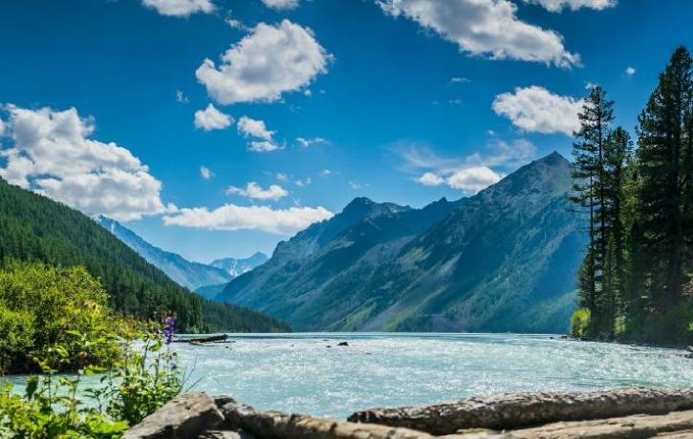
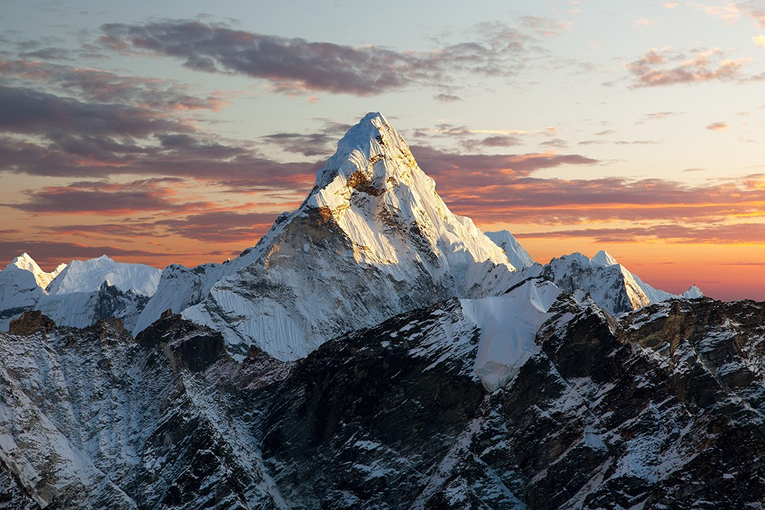
mountains
Rise above surrounding landscape
Steep sides and high peaks
Some reach high into the atmosphere where it is so cold snow is found on peaks

Slide 33
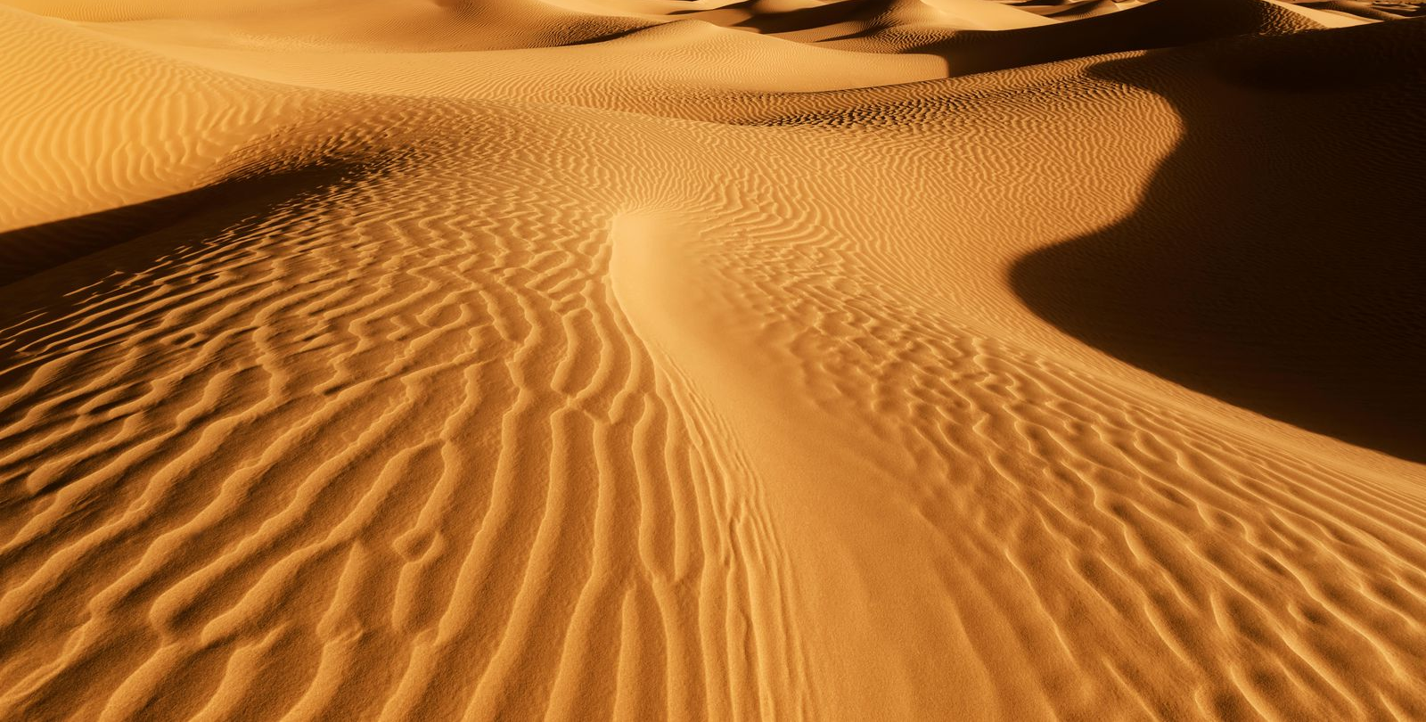
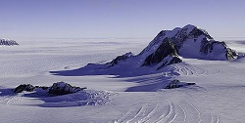
Deserts
Areas of low rainfall (arid/dry environment)
Experience temperature extremes (hot by day, freezing by night)
Not all are hot!
Antarctica is a cold desert
Largest desert → Gobi desert is a cold desert

Slide 34
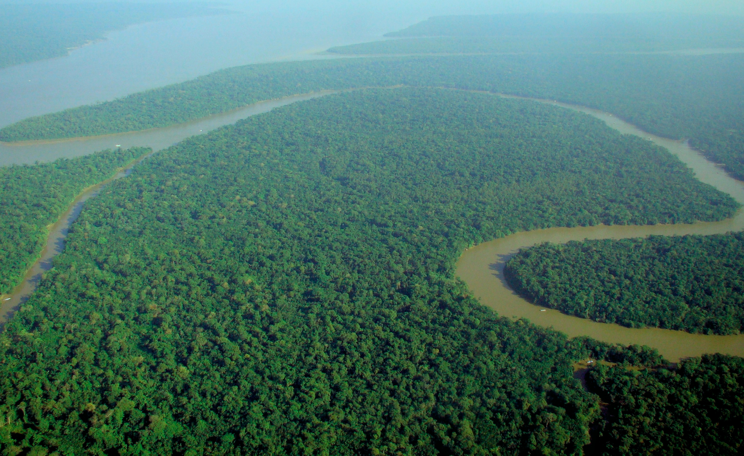
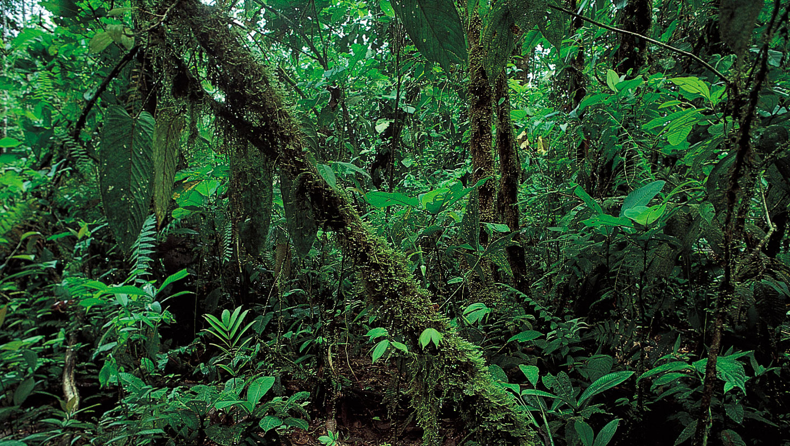
rainforests
Most diverse landscape on Earth
Found in variety of climates – hot wet topics & cooler temperature areas
Lush vegetation is a result of high rainfall levels
Over 50% of all animal and plant species are found within them

Slide 35
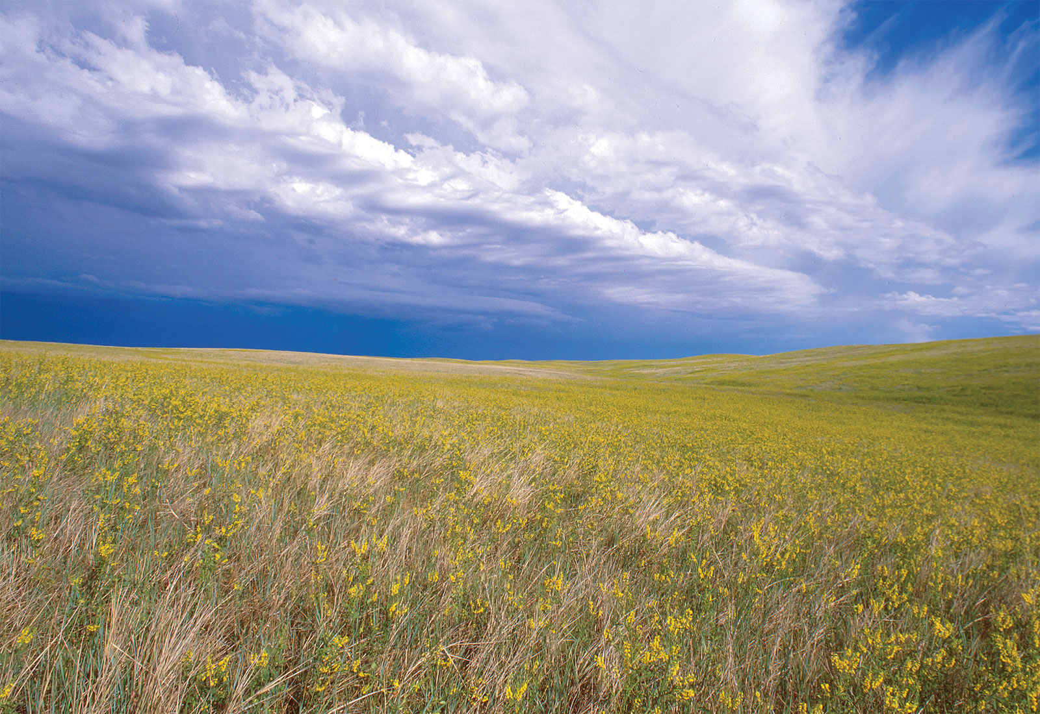
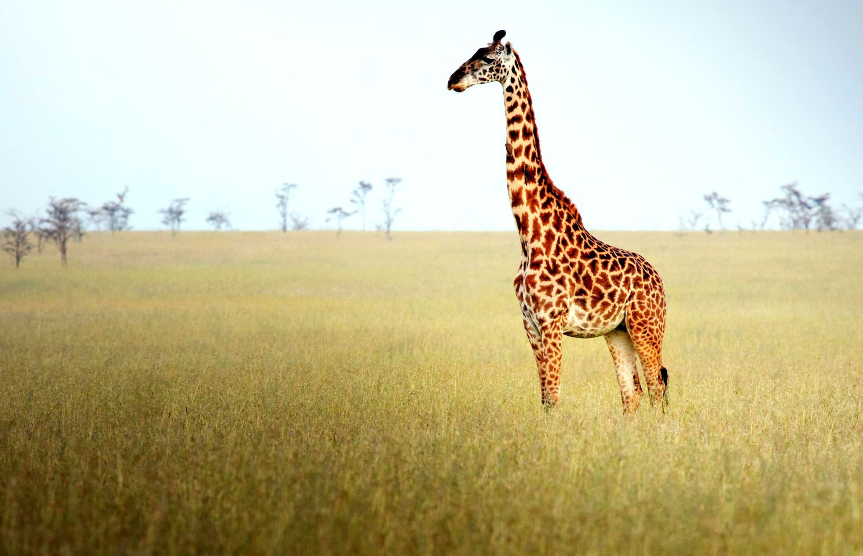
grasslands
‘Savanna’
Transitional landscape between forests and deserts
Height and coarseness of grass are varied
Inhabited by grazing animals

Slide 36
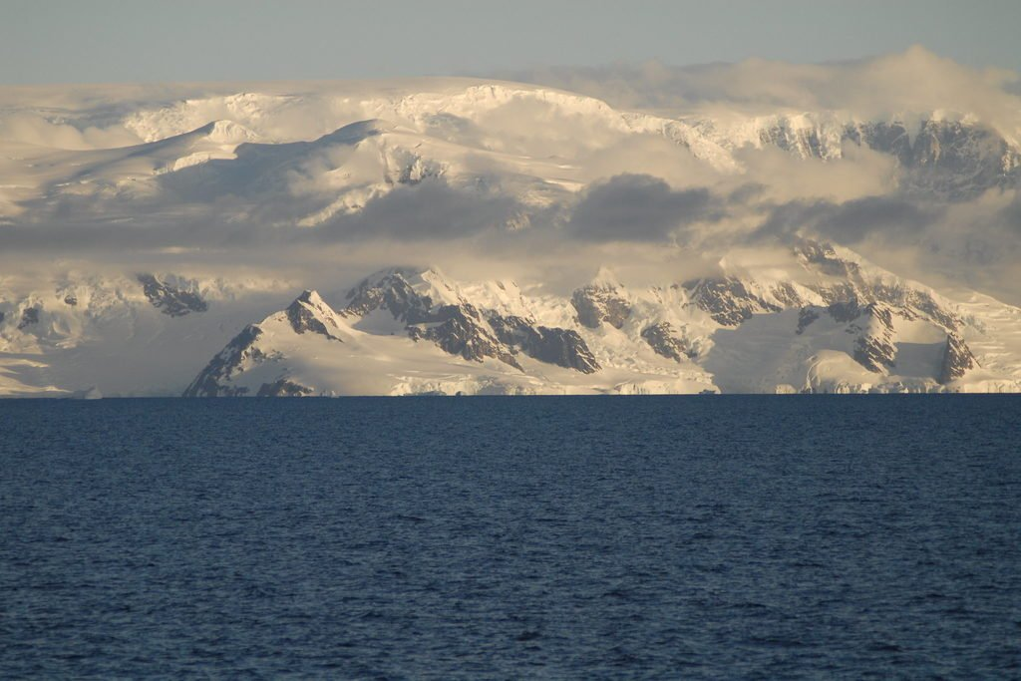
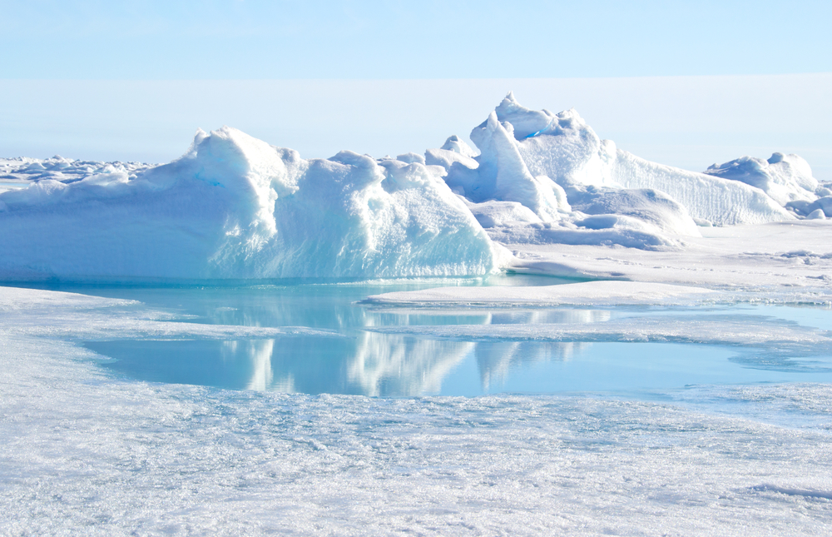
Polar regions
Found in polar and alpine regions
Characterised by ‘permafrost’ – too cold for trees to grow
Dwarf shrubs, grasses and lichens have adapted to extreme cold
Glaciers carve landscape features

Slide 37
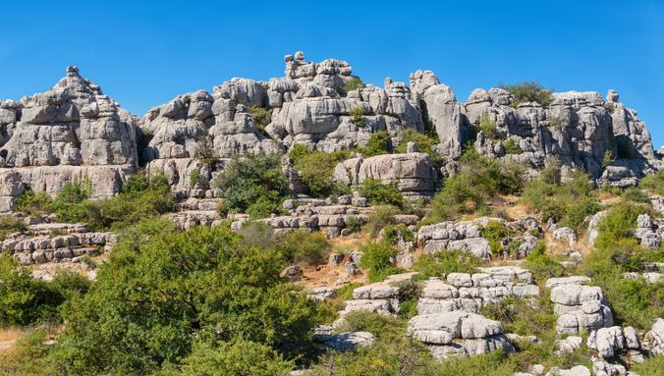
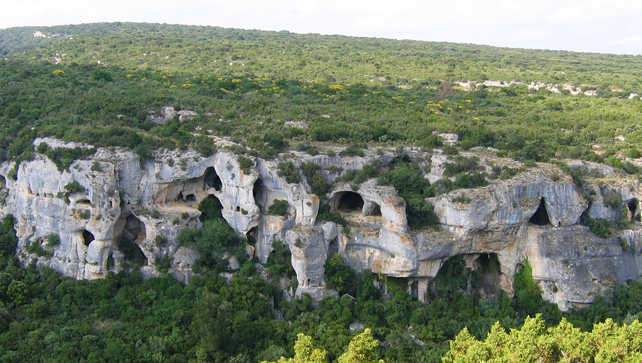
Karst landscapes
Mildly acidic water flows over soluble rock (limestone)
Fractures form which increase in size and lead to underground drainage

Slide 38
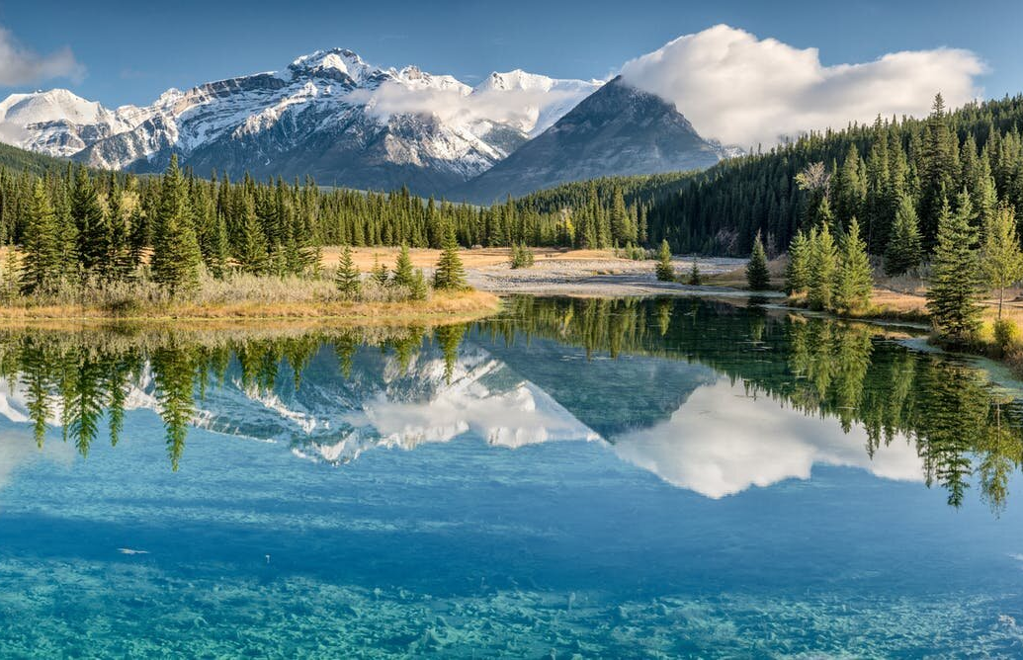
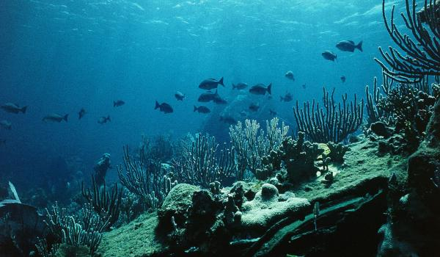
Aquatic landscapes
Cover ¾ of the Earth
Classified as freshwater or marine
Marine = saltwater regions of the world (oceans, corals, reefs)
Freshwater = found on land (lakes, rivers and wetlands)

Slide 39
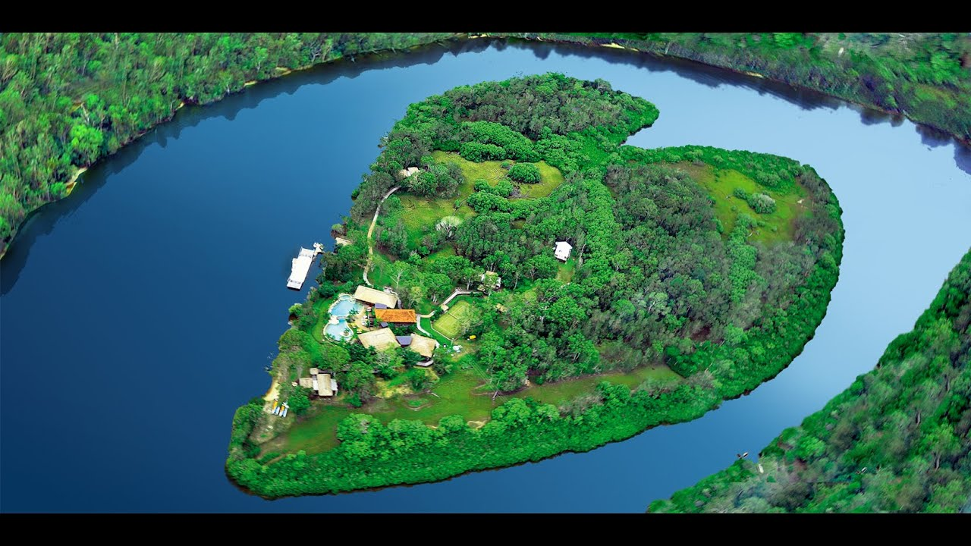
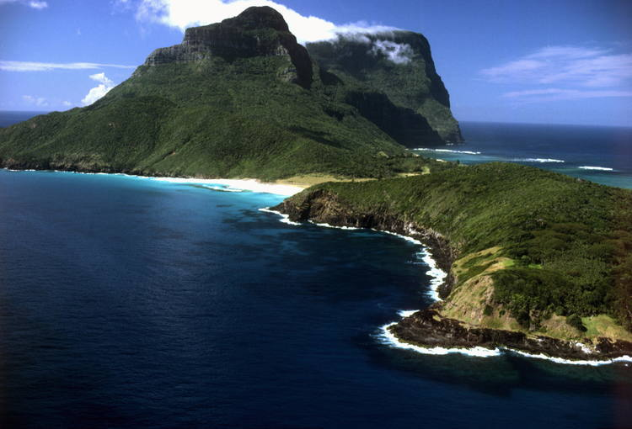
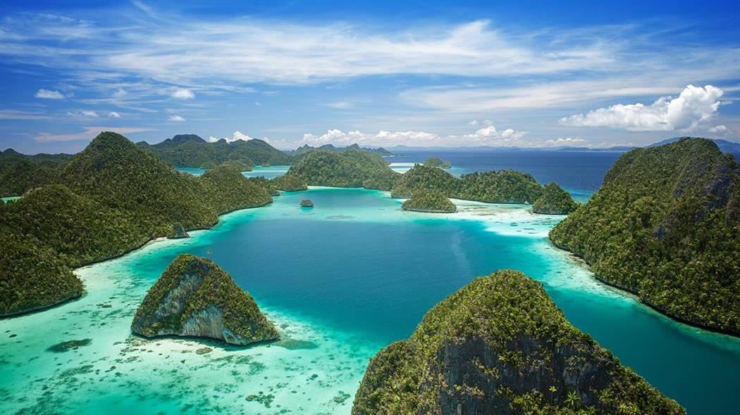
Islands
Areas of land surrounded by water
Continental = extension of a continent submerged beneath sea (continental shelf)
Oceanic = rise from ocean floor and generally volcanic in origin
Group/chains of islands = archipelago

Slide 40
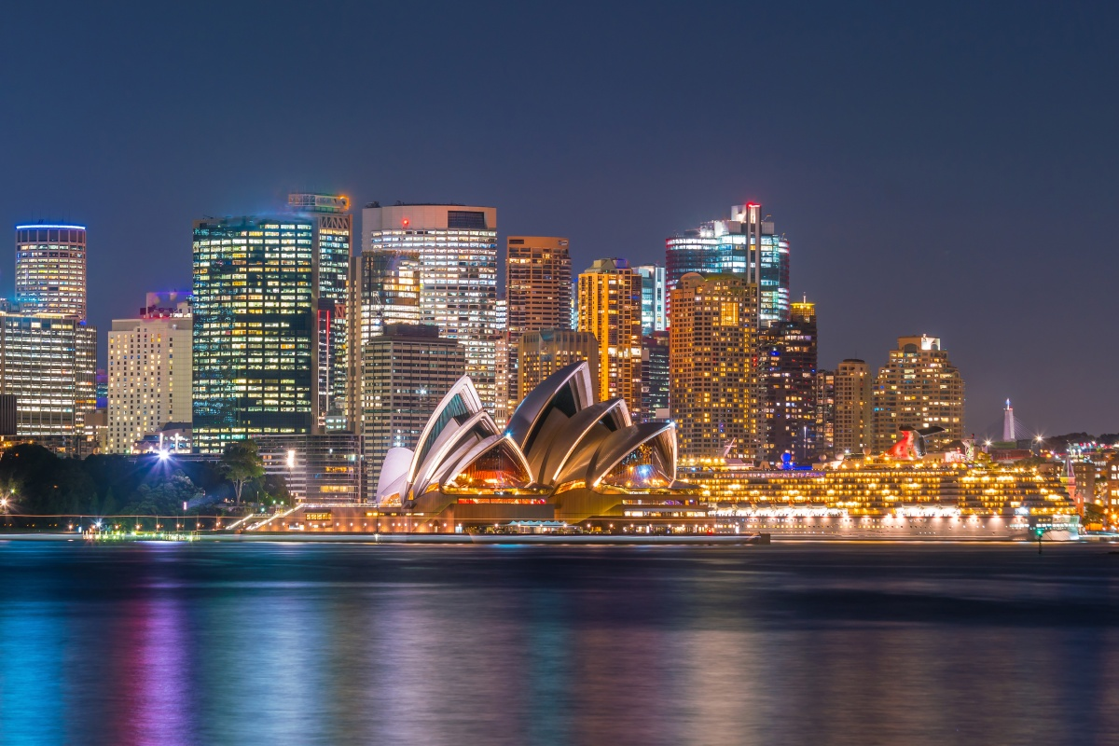
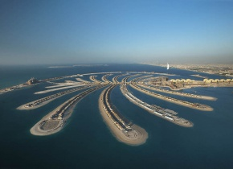
Built landscapes
Landscapes altered or created by humans
Patterns of streets, blocks of land, buildings and infrastructure of a urban place are built landscapes

Slide 41
Different types of landscapes
Mountains
Polar regions
Deserts
Karst landscapes
Rainforests
Aquatic landscapes
Grasslands
Islands
Built landscapes

Slide 42
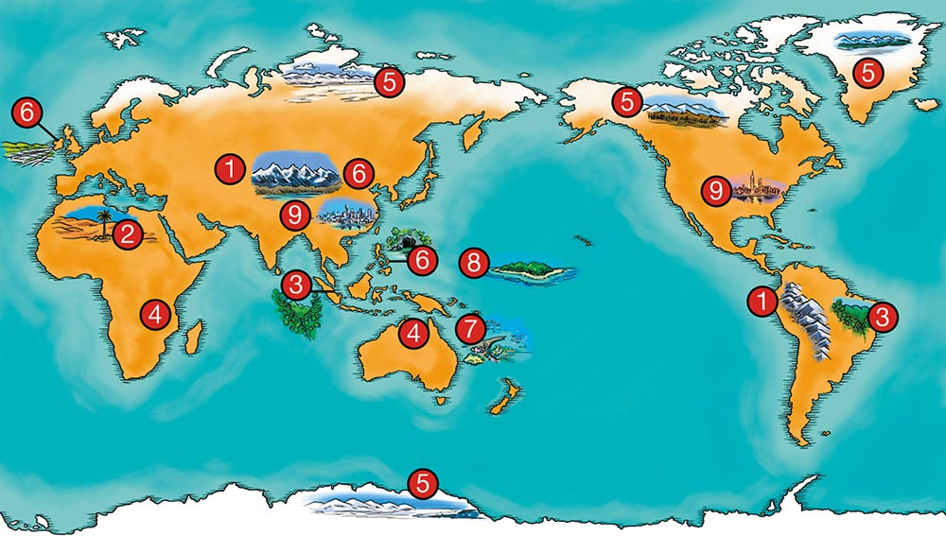
1 | 2 | 3 | 4 | 5 | 6 | 7 | 8 | 9
Mountains | Deserts | Rainforests | Grasslands | Polar Regions | Karst Landscapes | Aquatic Landscapes | Islands | Built Landscapes

Slide 43
Rainforests
Year 8 Geography

Slide 44
Virtual Field Trip - Amazon Rainforest
https://www.youtube.com/watch?v=JEsV5rqbVNQ

Slide 45
Q. How does the interaction between Earth’s four main systems (or spheres) produce rainforest landscapes?
Each process helps in creating and sustaining a rainforest. Biosphere, which is the creation of nature on the world, would create the trees and empty rivers. The Hydrosphere, responsible for the Earth’s water, fills up the empty rivers, and also allows the water to evaporate, thus causing the water cycle. The Lithosphere, being the core of the earth, will support the rainforest from below. Finally, the Atmosphere, responsible for the weather, would support the water cycle, as once the water evaporates, it becomes water vapour, then the Atmosphere will make it rain, thus allowing the forest to become a rainforest due to its average rainfall per year.
Biosphere
Hydrospere
Lithosphere
Atmosphere

Slide 46
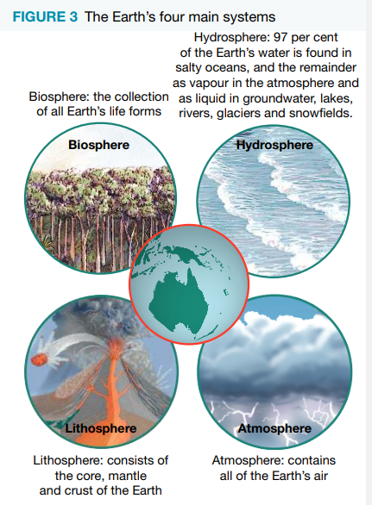
The Earth’s four main systems
An example may be: The trees in a tropical rainforest (biosphere) rely on high levels of precipitation (hydrosphere), warm temperatures (atmosphere) and stability provided by soil (lithosphere) to thrive. Energy from the sun is stored by plants (biosphere). When humans or animals (biosphere) eat the plants, they acquire the energy originally captured by the plants.
Notes:
Write

Slide 47
Name and describe each different layer of a rainforest as part of an ecosystem.
The emergent
The canopy
The understorey
The forest floor

Slide 48

Jigsaw: 1st Look up 1 area with your group (1111), then we will change group (1234):
Group 1 - Emergent
Group 2 – Canopy
Group 3 – Understorey
Group 4 – Forest Floor
Notes:
Stage 1: What is it? What lives there? Why is it important?
Stage 2: Part 1 – Explain your area of investigation…
Part 2 -How would they interact

Slide 49
Stage 1: What is it? What lives there? Why is it important?
Stage 2: Part 1 – Explain your area of investigation…
Part 2 -How would they interact?

Slide 50
Exercises 6.2
Check your understanding of ALL question of exercise 1 (p154-155).

Slide 51
Resources
http://www.blueplanetbiomes.org/rainforest.htm
http://displays.tpet.co.uk/?resource=633#/Search/Rainforest
http://featuredcreature.com/tokay-geckos-are-biters/
http://pulpbits.com/7-rainforest-animals-clipart/cool-earth-rescue-the-rainforest-campaign-clipart/
http://animals.nationalgeographic.com/animals/amphibians/red-eyed-tree-frog/
http://www.srl.caltech.edu/personnel/krubal/rainforest/Edit560s6/www/animals/macawpage.html
http://mrsgebauer.com/rainforestweb/WebQuest.htm
http://www.tropical-rainforest-facts.com/Tropical-Rainforest-Layer-Facts/Tropical-Rainforest-Layer-Facts.shtml
http://animals.nationalgeographic.com/animals/mammals/orangutan/
http://www.tigerhomes.org/animal/layers-rainforest.cfm
http://www.stri.si.edu/sites/rainforest/rainforest_layers.html
http://www.thinkingfountain.org/s/strata/strata.html
http://picture.webspier.com/tropical_rainforest_plants_pictures.html
Tropical Rainforest Video with Great Facts and Summarization
https://www.youtube.com/watch/?v=ezGjPmz7LEY
https://www.youtube.com/watch?v=dWbqBNDjQlk
https://www.youtube.com/watch?v=JEsV5rqbVNQ (Virtual Tour)
AMAZON SLIDESHOW OF IMAGES
http://kids.mongabay.com/slideshows/amazon-tour/

